Slide 1
MeowMeal2000
Kairui Zhang

Slide 2
Problem & Solution
When people are not home they cant feed their pets
Pets get hungry and that is not good
Idea: automatic timed pet feeder

Slide 3
How it works
Servo rotation to make drop food to pets
Led screen count down for next feed
use a bottle as a food container

Slide 4
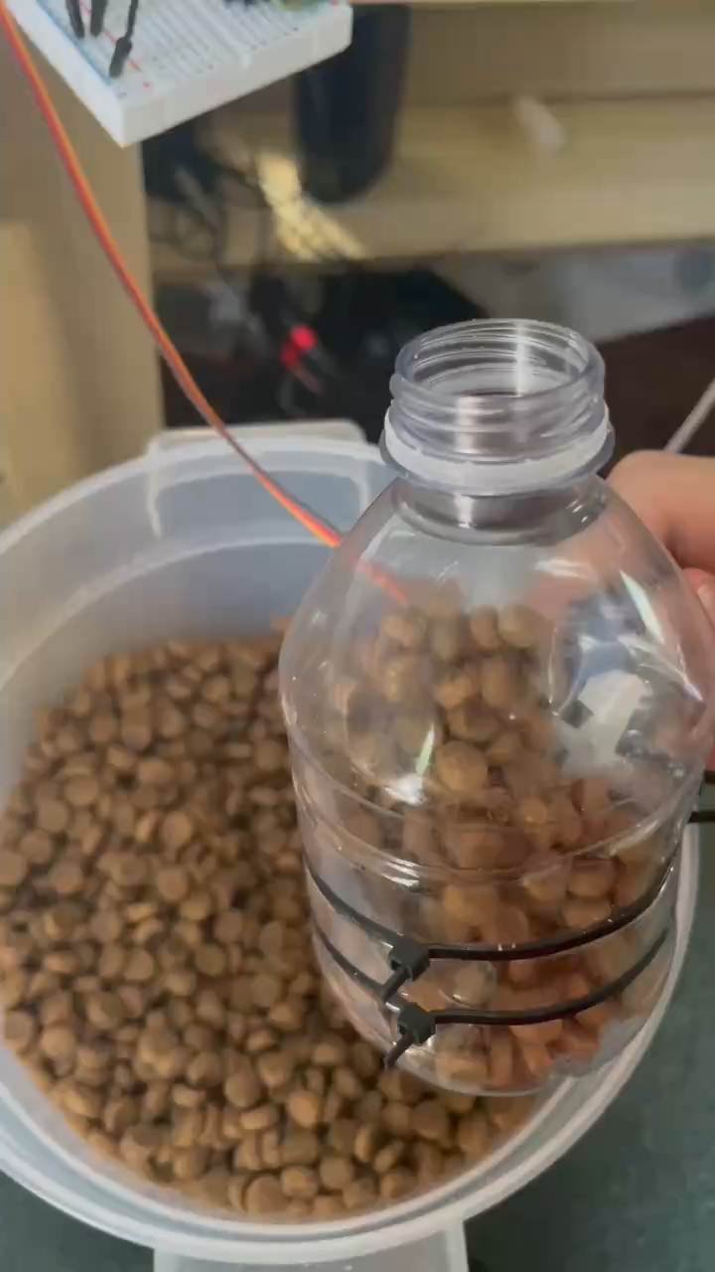
Video demo

Slide 5
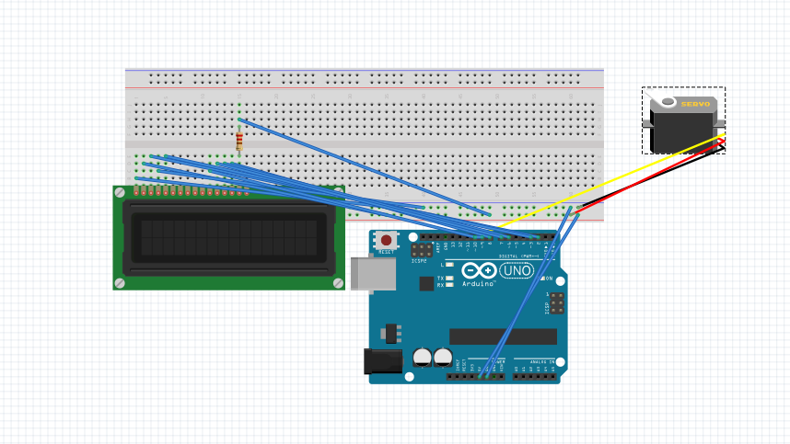

Slide 6
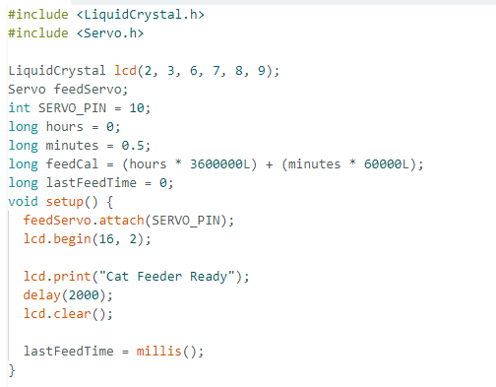
Declare all varibles and set the times,
Millis for timer

Slide 7
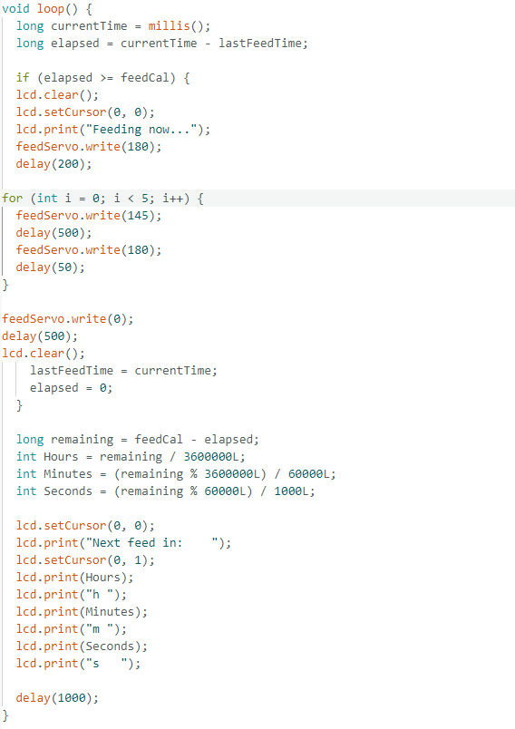
Check timer if it reach desired time than rotate the bottle and drop the food display the time on LCD

Slide 8
Price
$15 could be found in pet shop (ex. Petco)

Slide 9
Questions?

